Slide 1
Iftekhar Riyadh 1610670042
Tasfia Nausheen 1711488042
Avisheik Barua 1721158042
Maruf Hossain 1412604642
SM Nasif Sadiq 1530117642
Online Grocery Shop

Slide 2
Outline
History
Motivation
System Diagram/Flowchart
System Description
Design Implementation
Working Demo
Output/Result
Conclusion
Future Development

Slide 3
History
The backward 1990s was a time of great enthusiasm for internet retailers. Consumers had just begun ordering products online, and there was a generally held view that this new method of shopping would change the industry.
As the most significant single local sector, the grocery was a new area of focus.

Slide 4
Motivation
It saves time.
Shopping online alleviates the need to walk up and down store aisles.
No Unwanted Luxury Purchases.
Find Everything You Need.
You Can't Personally Look at Items.
Delivery can be a challenge.
Price.

Slide 5
System Description
System Description: The Website is mainly for grocery items. There are many different categories of items. There are a admin for the page who can control all the things like add or remove products, limit users, give off in any item etc. There are also a user login panel where one user can see their product details and their information’s..

Slide 6
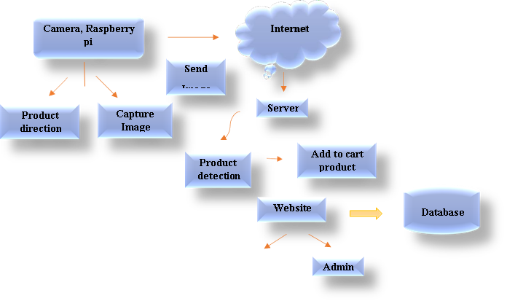
System Diagram

Slide 7
Design Implementation
Design Implementation We are mainly working CSS for the design of the page. Also use bootstrap and php for backend and connection with the database. We are also working on Artificial Intelligence for the search bar.

Slide 8
Working Demo
https://drive.google.com/file/d/16T26JGA0LnevrQMd6kmnVgrtO2OsNrFF/view?fbclid=IwAR2Dxli8A5LIhA10oAlchZrG5C6vXi_u3F5Ba_fA71ua0yyMGQM4qVeVZ4k

Slide 9
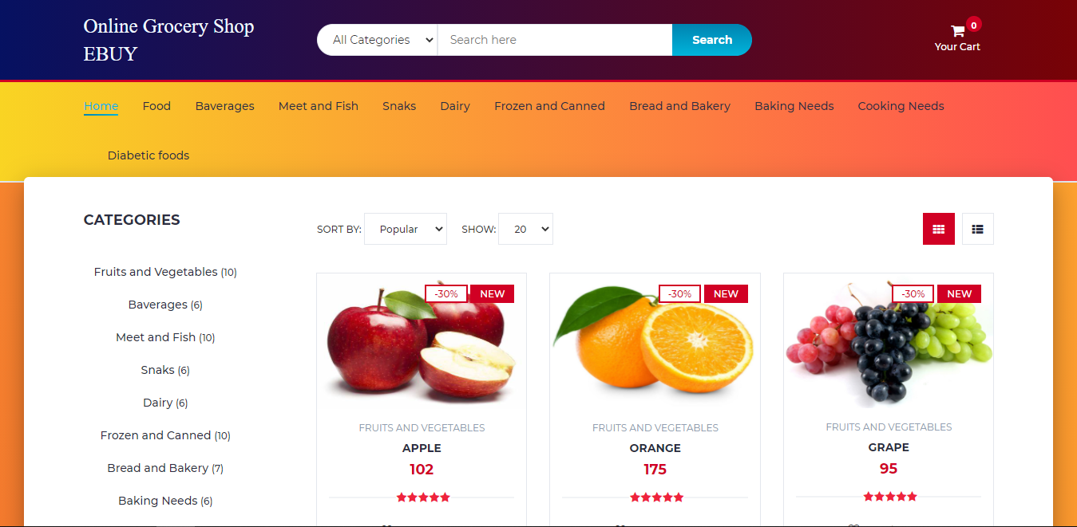
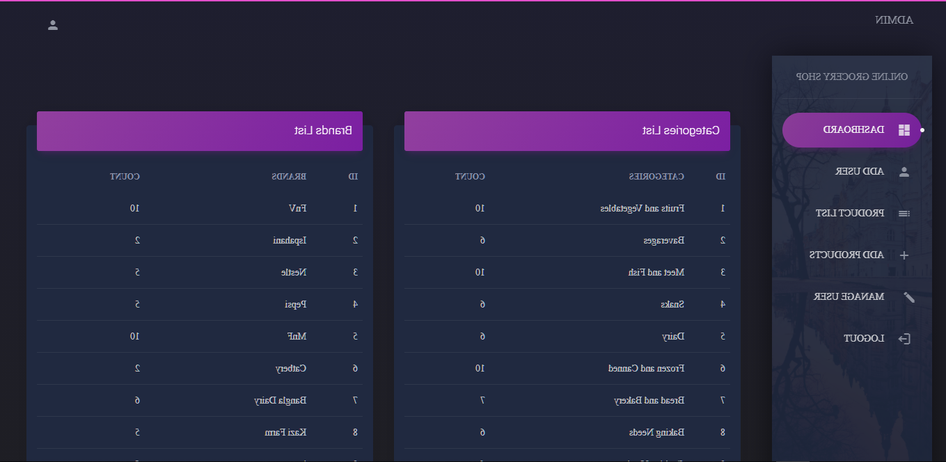
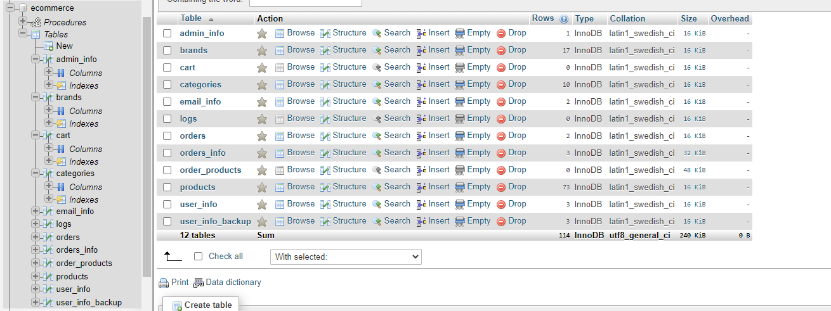
Output
Snapshot

Slide 10
Conclusion
The sole purpose of this project is for customers to achieve maximum efficiency while shopping and to reduces the time it takes to shop physically. For now, that is, for CSE 499A we used HTML, CSS, JavaScript, Bootstrap as front end and PHP as back end and MySQL for the database. The system is strong enough to withstand regressive daily operations under conditions where the database is maintained and cleared over a certain time of span. The implementation of the system in the organization will considerably reduce data entry, time and also provide readily calculated reports.

Slide 11
Future Development
In CSE 499A, we just completed the basic usable website where both backend and front-end is done. In the next part of the project, that is, in CSE 499B, we plan on making the website more efficient and useful for the users by adding “image processing” which will help users find any product by just capturing the products image through their phone, it will be time saving for the users and also search engine bar which was missing in CSE 499A part.

